Slide 1


Online Retailer Customer Segmentation
Data Science Capstone
Spring 2022 SECS 7259-01 22124

Slide 2
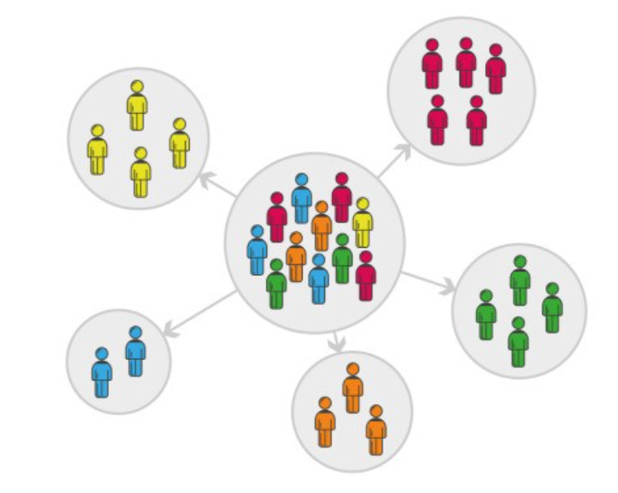
Online Retailer: Business Objective
Need to explore: E-Commerce past infancy
Maximize efficiency leads to profits
Understand customers key to success
Business Objective: Understand customer to enhance Product offering and maximize profit
Scope and Design: Customer Segmentation
Data preparation: Data Exploration, Data Cleaning
Descriptive analysis: Visuals to derive insights
Unsupervised learning model: Clustering
Dimensionality reduction
Baseline: RFM Model
Elbow method and Silhouette score to find optimal clusters
K-Means Cluster analysis
Model iteration and best fit
Evaluating model
Model Implementation
Stakeholders: Online Retailer, Customers, Support functions

Slide 3
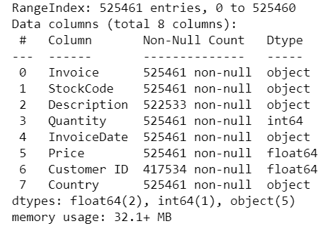
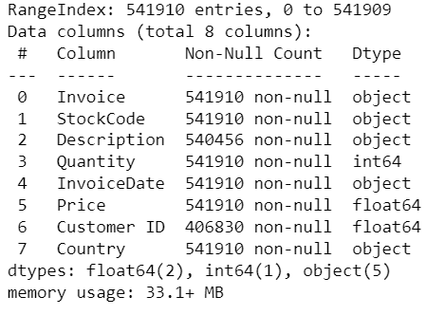
Data Acquisition
- Transactions for a UK-based and registered, non-store online retail between 01/12/2009 and 09/12/2011
- Source: Dr. Daqing Chen, Course Director: MSc Data Science. School of Engineering,
London South Bank University, London SE1 0AA, UK.
https://archive.ics.uci.edu/ml/datasets/Online+Retail+II
Reference:
https://www.kaggle.com/datasets/lakshmi25npathi/online-retail-dataset?select=online_retail_II.xlsx
Online Retail: Year 2009-10
Online Retail: Year 2010-11

Slide 4
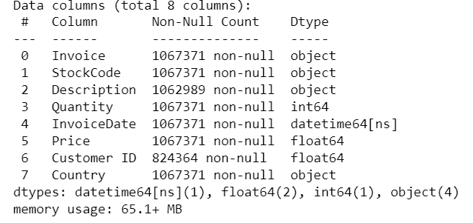
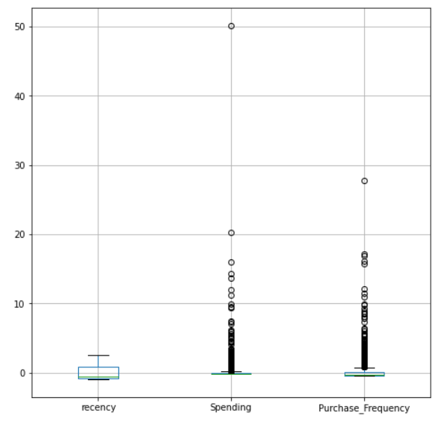
Online Retailer: Data Cleaning
Step 1: Combined 2 worksheets:
Year 2009-10 and 2010-11
Total 1067371 entries
Step 2: Removed entries without Customer ID
Reduced to 824364 entries
Step 3: Outliers: Negative Quantity and Price
Step 4: Normalization to scale
Step 5: Removed Non UK dataset

Slide 5
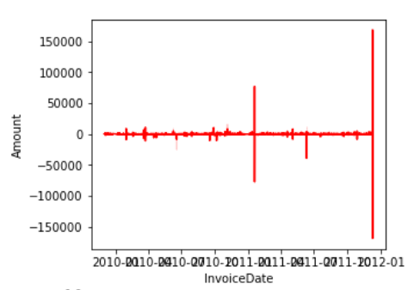
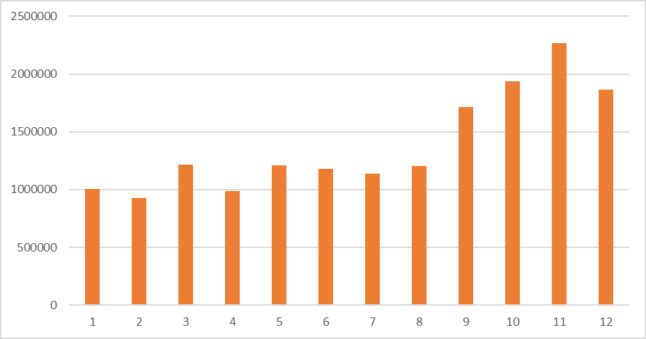
Online Retailer: Exploratory Data Analysis
Revenue Generated in 2 years
5942 customers spent on average 2801.80 currency
Each customers had purchased on average approx. 7.5 times in 2 years, at least once and at most 508 times
On average, 293.97 spent by a customer on a purchase
75% of customer purchases with 357.41
Most Customers and most revenue generated from United Kingdom
Ireland, Netherlands, Germany, France, and Australia - top Revenue generating countries/ markets
Seasonality in revenue generated
Peak months: Q4 – Oct to Dec
Month over Month: Revenue Generated

Slide 6
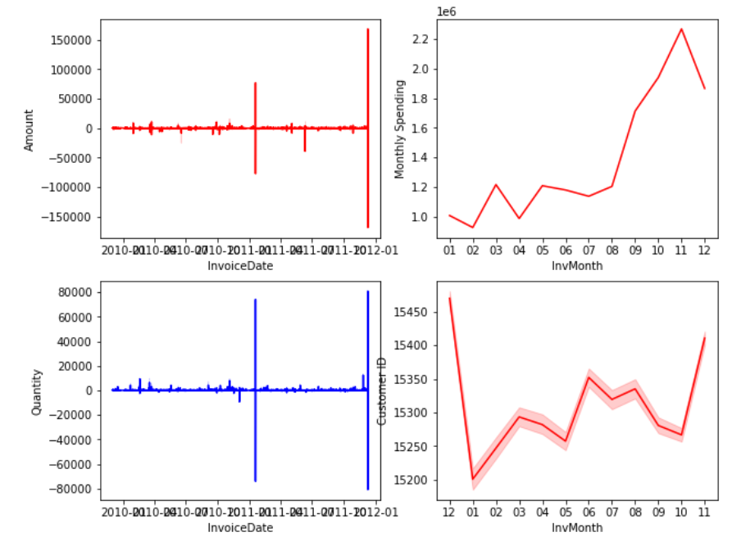
Online Retailer: Exploratory Data Analysis
Further review of Cancel Orders:
Mainly coincided with peak order days
About a third of customers cancelled orders
Equates to just 8% of revenue
Top 3 Most cancels by Countries that order revenue with in Top 5:
United Kingdom
EIRE
France
About 49% of products have had cancelled orders

Slide 7
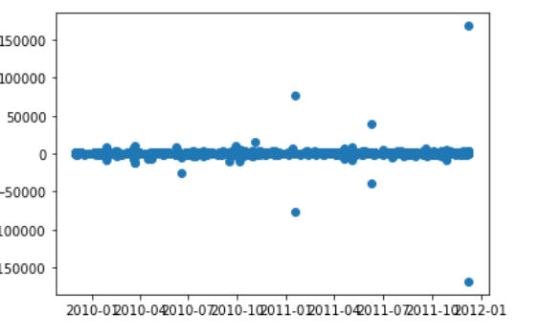
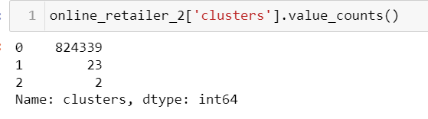
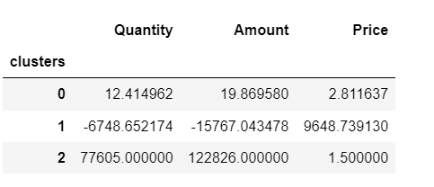
Online Retailer: Baseline
Scatter plot of Revenue Generated
Scatter plot of revenue to time distribution indicated 3 clusters
Cluster 0: Orders with moderate revenue generation
Cluster 1: Orders that were cancelled and resulted in loss of revenue
Cluster 2: Orders with high revenue generation
K Means with 3 clusters shows similar composition as scatter plot clusters
Segment of customer who is the big spender but what if they purchased only once or how recently they purchased?
Clusters Composition: v1

Slide 8
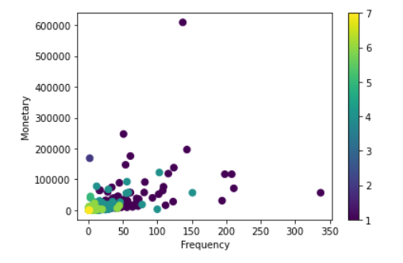
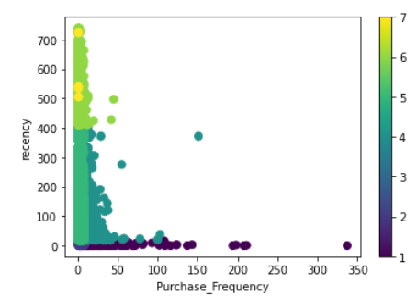
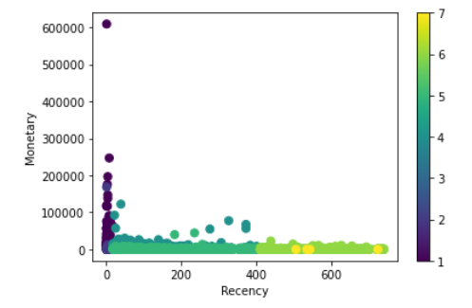
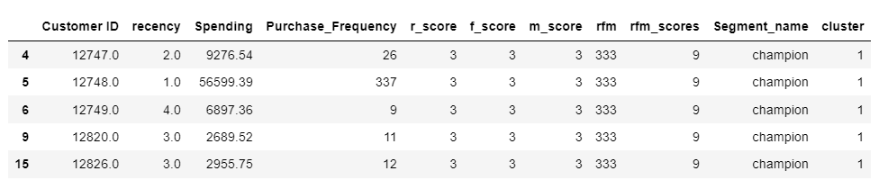
Online Retailer: RFM Model
Scatter plot: RFM Segments
Customer behavior segmentation technique
Recency,
Frequency,
Monetary
Each component split into quantiles
Scores for each component assigned from quantiles
Overall Score generated based on
how recently customer bought products,
how often customer buys, and
how much money was spent by customer,
Based on each component and with Recency at higher weights, model designed with 7 clusters
RFM and scores

Slide 9
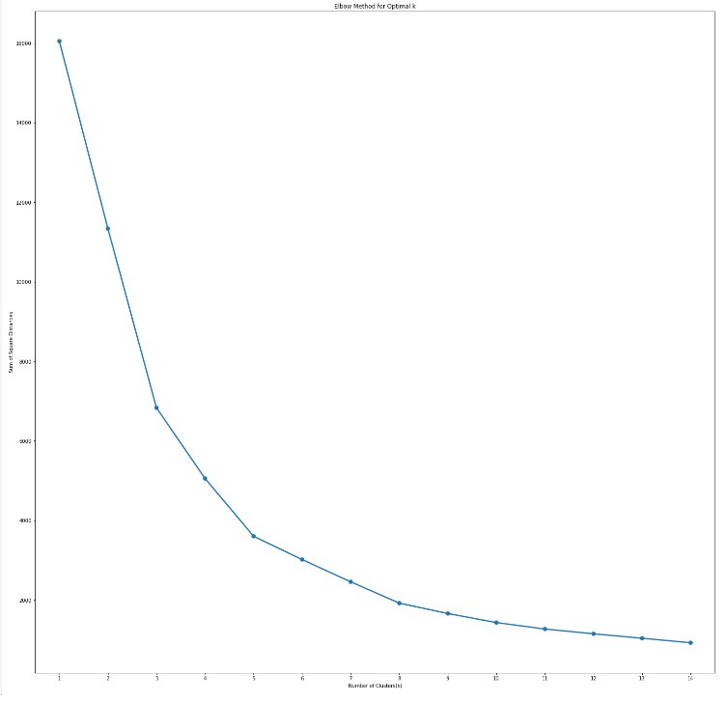
Online Retailer: Elbow Method
Elbow method
Most popular methods to determine Optimal value of k – Elbow method
It is a plot of explained variation for a range of number of clusters
Using the "elbow" as a cutoff point for number of clusters so that adding another cluster doesn't give much better modeling
Elbow method to find optimal K indicates 5 clusters

Slide 10
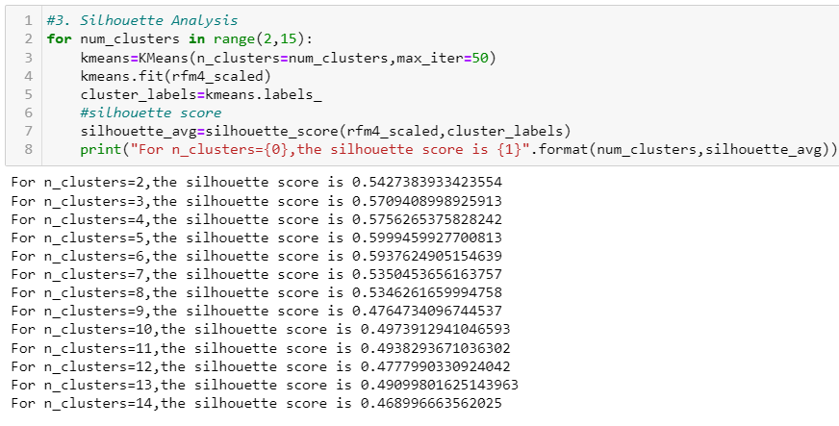
Online Retailer: Silhouette Score
Silhouette Analysis for Clusters
Silhouette Coefficient or score is a metrics to calculate goodness of clustering technique
1=> clusters are well apart from each other and clearly distinguished.
0 => clusters are indifferent, or we can say that the distance between clusters is not significant.
-1 => clusters are assigned in the wrong way
Applying on Online Retailer dataset, 5 clusters highest Silhouette coefficient
Silhouette score and Clusters

Slide 11
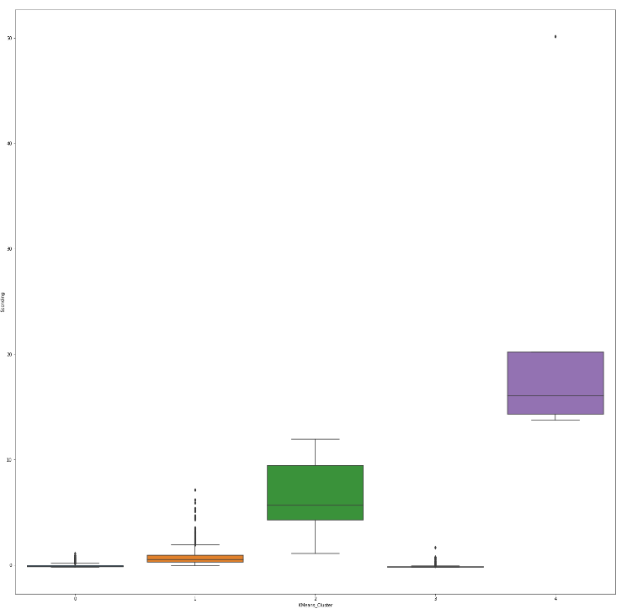
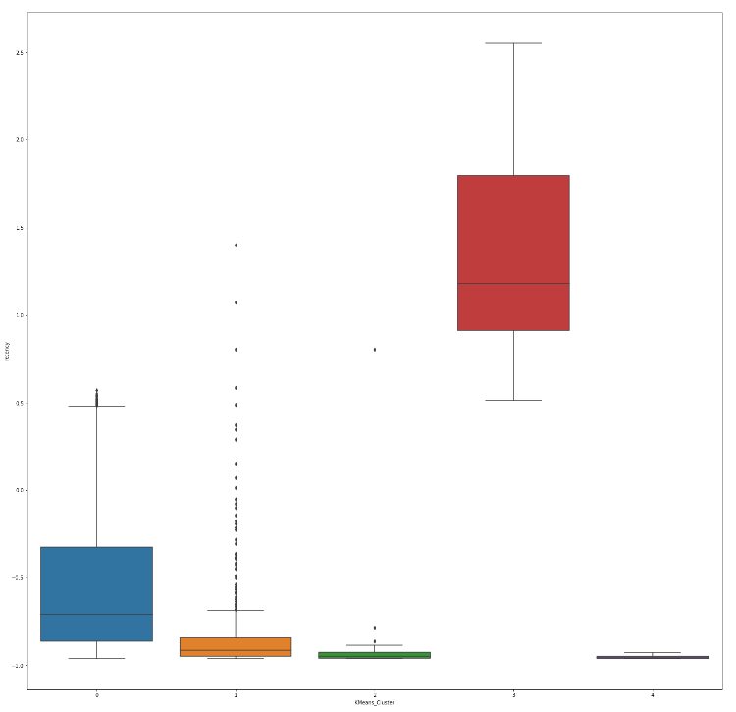
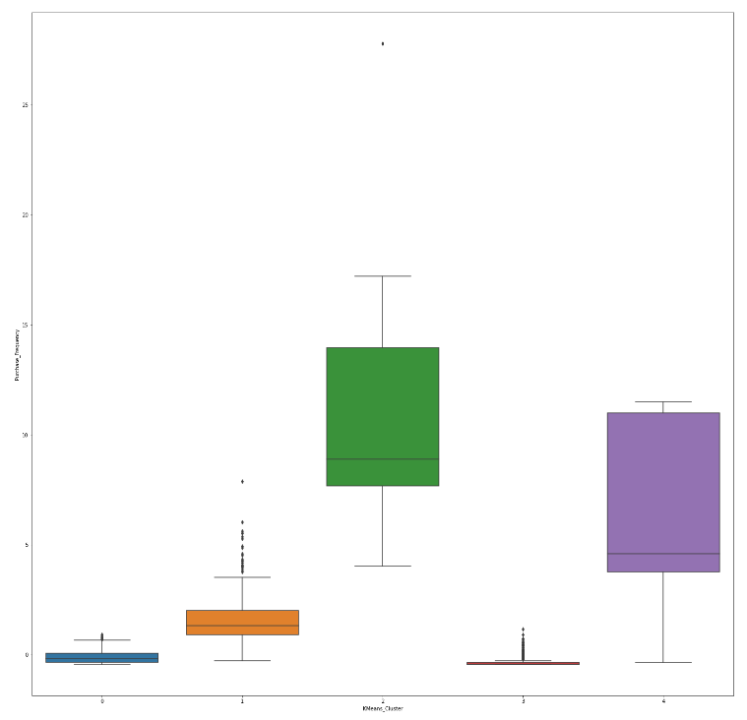
Online Retailer: Final model
K-Means identified 5 optimal Customer Segments or clusters
Cluster 0: Customer group who bought fairly recently, but fewer number of times and spending lower compared to others
Cluster 1: Customers who have recently purchased fairly high value products but did not repeat purchasing frequently
Cluster 2: Customers who have very high repeat purchases and higher spending, and recently purchased
Cluster 3: These Customers have not purchased in a very long time and have high churn while spending very little
Cluster 4: This is the best group of customers who buy very frequently and spent the most. Also they bought very recently
Spending/Monetary across Clusters
Recency across Clusters
Purchase Frequency across Clusters

Slide 12
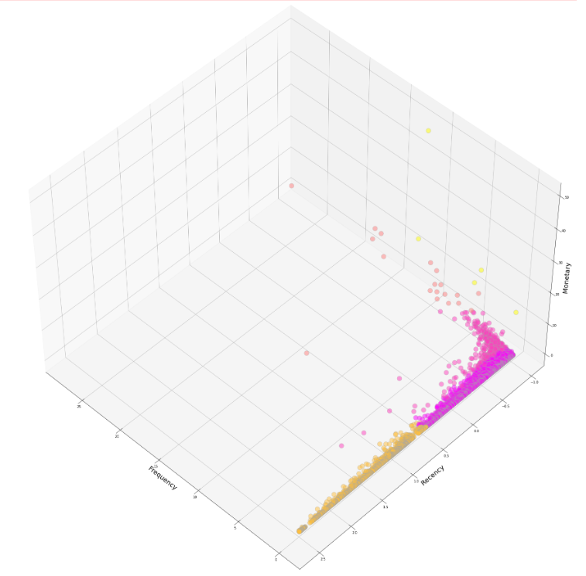
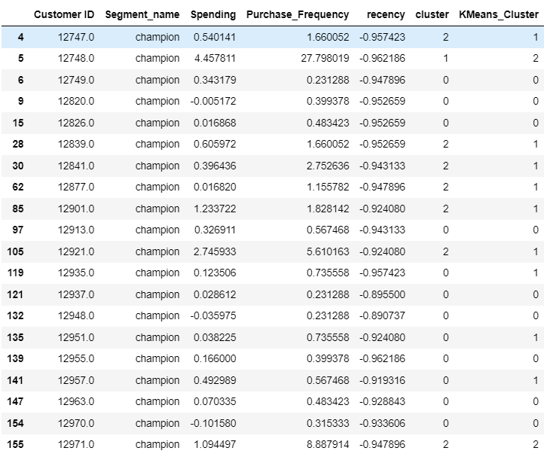
Online Retailer: K Means
3D chart of 5 clusters
K Means Clusters: 5 optimal

Slide 13
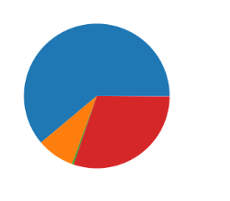
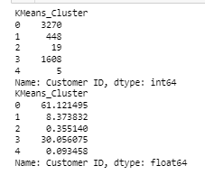
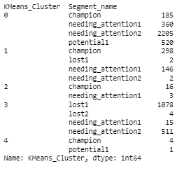
Online Retailer: RFM Segment vs. K Means Clusters
61% of customers are in K-Means Cluster 0
Overlap in Segments identified with RFM Scores vs. K Means Clusters
Champions: high Recency, high Frequency, high Spending spread across 4 K-Means clusters
59% in K Means Cluster 1
37% in Cluster 0
3% in Cluster 2
1% in Cluster 4

Slide 14
Online Retailer: Conclusion
61% of customers in Cluster 0
Grow this group with Marketing plan to drive more frequent purchase utilizing recommenders, coupon offerings for related past purchases
30% of customers not purchased recently.
Likely to churn
Nurture campaigns to bring back the group
Cluster 1 is 8% of customers
Purchased fairly recent, bought high value products, did not purchase frequently
Likely dissatisfied customers
Feedback campaigns to increase engagement

Slide 15
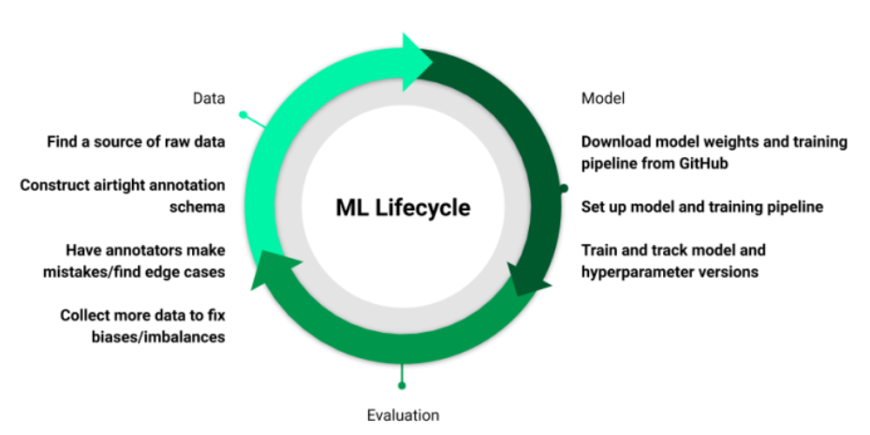
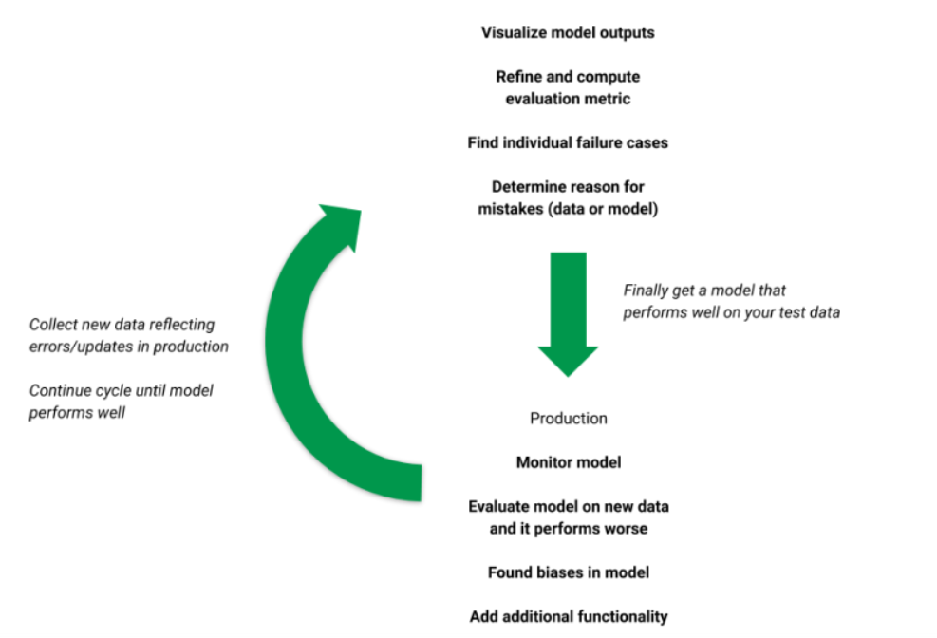
Online Retailer: Next Steps
Model deployment and Validation
Canary deployment strategy: Gradually add customer country
Internal Validation: Evaluating the fitness and Stability of clustering
Geometrical Properties of cluster like Compactness, Separation, Connectedness: Average Silhouette Width, and Bayesian information criterion (BIC)
Reference: https://neptune.ai/blog/model-deployment-strategies
Source: The Machine Learning Lifecycle in 2021

Slide 16
Online Retailer: Model Profiling
Risks of model:
Every clustering algorithm will find clusters in a dataset, even if there is no cluster structure in it
Outliers
Country specific
No Cancel orders
Extreme outliers will skew clusters
Stakeholders for project:
Online Retailer, Customers, Support functions
Marketing team for building nurture campaigns via emails, texts
Finance team for determining profitable offers and discounts
Product purchase and maintenance team for stocking products
Data Science team for building and maintenance of Customer segmentation model

Slide 17
Next Steps:
Optimize product offerings by customer segments
Design Recommenders to assist customer segments

